Slide 1

ITA0329– MOBILE COMPUTING
PROJECT TITLE
“1G to 5G Evolution Interactive Learning Platform.”
PRESENTED BY
Duddela Harika(192324301)
Nirosha M(192311411)
GUIDED BY
Dr. Saravanan. M. S

Slide 2
INDEX
ABSTRACT
INTRODUCTION
PROBLEM STATEMENT AND OBJECTIVES
EXISTING SYSTEM AND PROPOSED SYSTEM
METHODOLOGY
MODULES
RESULTS
IEEE STANDARDS
SDG CONTRIBUTION
CONCLUSION
REFERENCES

Slide 3
ABSTRACT
The 1G to 5G Evolution Interactive Learning Platform is a mobile app that helps students learn how mobile networks changed from 1G to 5G.
It shows each generation’s data rate, spectrum band, latency, technologies and services in a simple, visual way.
Purpose of the Project
Learners explore an interactive timeline, compare generations using charts, and take gamified quizzes.
The app records quiz score, engagement time and comparison accuracy to measure learning.
It makes a difficult topic easy, interesting and available anytime on a phone.

Slide 4
INTRODUCTION
Mobile networks have grown from 1G (voice only) to 5G (very high speed, low delay and smart devices).
Textbooks explain this evolution in long text and tables, which students find hard to remember.
This app turns the same content into an interactive timeline, charts and quizzes.
Importances :
This system
  makes learning simple and interesting
  helps compare generations easily
  tests understanding through quizzes

Slide 5
PROBLEM STATEMENTS AND OBJECTIVES
Problem Statement:
Students find it difficult to remember mobile network generations from 1G to 5G.
Comparing speed, frequency, latency, and services is confusing.
Traditional study materials do not provide interactive learning or instant feedback.
Objectives
Content and Visualization Module
To display 1G to 5G information using timelines and charts.
To make comparing network generations easy.
Quiz and Assessment Module
To conduct interactive quizzes and provide instant feedback.
To track quiz scores, learning time, and comparison accuracy.

Slide 6
EXISTING SYSTEM AND PROPOSED SYSTEMS
Existing System:
Students learn from textbooks, notes and slides.
No interaction or practice for the learner.
Comparing generations takes a lot of effort.
No tracking of learner progress.
Proposed System:
An interactive Android / React Native app for 1G to 5G.
Timeline shows the evolution step by step.
Charts compare data rate, latency and spectrum band.
Gamified quizzes give feedback; progress is tracked.

Slide 7
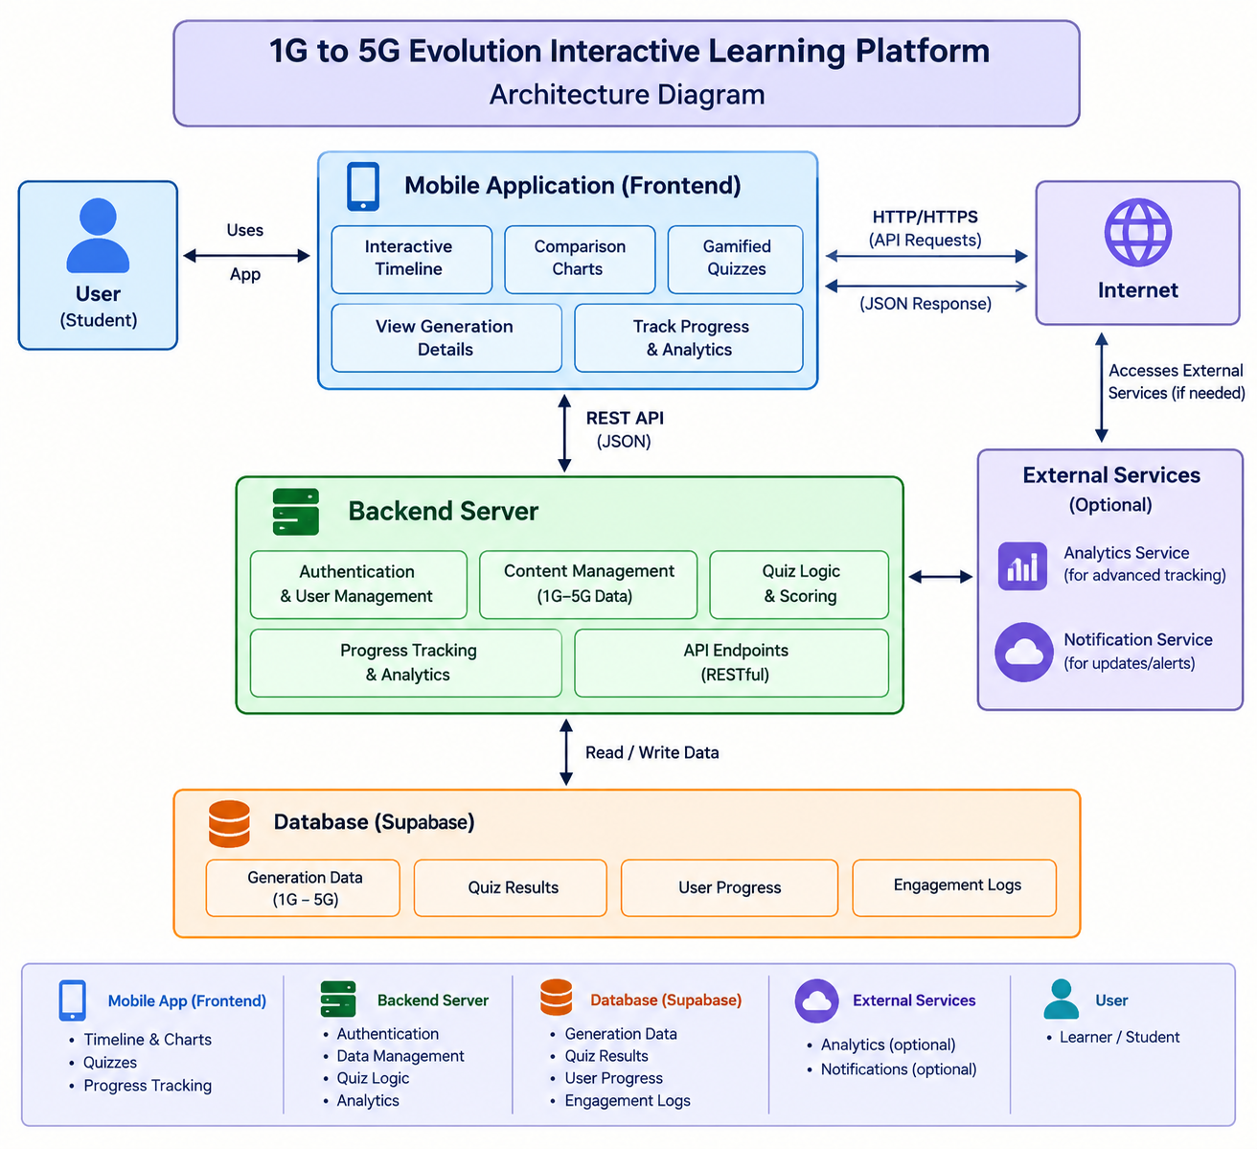
METHODOLOGY

Slide 8
Module -1: Interactive Timeline & Data Visualisation
This module shows the evolution from 1G to 5G on a scrollable timeline.
The learner taps a generation to see its data rate, spectrum band, latency, technologies and services.
Bar and line charts (MPAndroidChart) compare generations side by side.
Data comes from the SQLite content store, so it works offline.
Key Functions:
Displays each generation in order of time.
Shows details of the selected generation.
Draws charts to compare two or more generations.

Slide 9
MODULE 2: Gamified Quiz & Progress Tracking
This module tests what the learner has understood.
Questions come from SQLite, with points, levels, badges and instant feedback.
It saves quiz score, engagement time and comparison accuracy for each learner.
Feedback from a student group is used to improve the app.
Key Functions:
Picks questions by generation or topic.
Calculates the score and gives instant feedback.
Shows a progress dashboard for the learner.

Slide 10
IEEE STANDARDS
1. Learning Technology Standards
  IEEE 1484.12.1 – Learning Object Metadata for organising learning content.
  IEEE 1484.1 – Architecture for learning technology systems.
2. Wireless Communication Standards
  IEEE 802.11 – Wi-Fi for downloading and updating content.
  IEEE 802.15.1 – Bluetooth for sharing with nearby devices.
3. Software Engineering Standards
  IEEE 12207 – Software life cycle processes.
  IEEE 29148 – Requirements engineering.

Slide 11
SDG CONTRIBUTION
The project helps students learn telecom concepts in an easy, interactive and affordable way.
SDG 4 – Quality Education
  Interactive lessons and quizzes improve understanding and support self-paced learning.
SDG 9 – Industry, Innovation, and Infrastructure
  Builds awareness of 5G and modern communication technology, supporting innovation.
SDG 10 – Reduced Inequalities
  Offline mobile access lets more students learn, even with limited internet.

Slide 12
CONCLUSION
Makes the 1G to 5G evolution simple and easy to understand.
Interactive timeline and charts help learners compare generations quickly.
Gamified quizzes improve interest, practice and memory.
Quiz score, engagement time and comparison accuracy show how well learners progress.
Works offline on a mobile phone using a SQLite content store.
Combines education, technology and innovation in a single app.

Slide 13
REFERENCES
Rappaport, T. S. (2002). Wireless Communications: Principles and Practice (2nd ed.), Prentice Hall.
Dahlman, E., Parkvall, S., & Sköld, J. (2020). 5G NR: The Next Generation Wireless Access Technology (2nd ed.), Academic Press.
ITU-R Recommendation M.2083-0 (2015). IMT Vision – Framework and overall objectives of IMT for 2020 and beyond.
Android Developers. Kotlin and Android app development documentation (developer.android.com).
MPAndroidChart – open-source chart library for Android (GitHub).

Slide 14
Thank You

